Slide 1
Budget Tracker
By: Talaiaa tanweer

Slide 2
Objectives
Help user manage their income and expenses effectively.
Gives an overview of your monthly spending
Key Features:
Add income and expenses
View budget summary
Categorized expense breakdown
Budget limit and alerts
Saving goal tracker

Slide 3
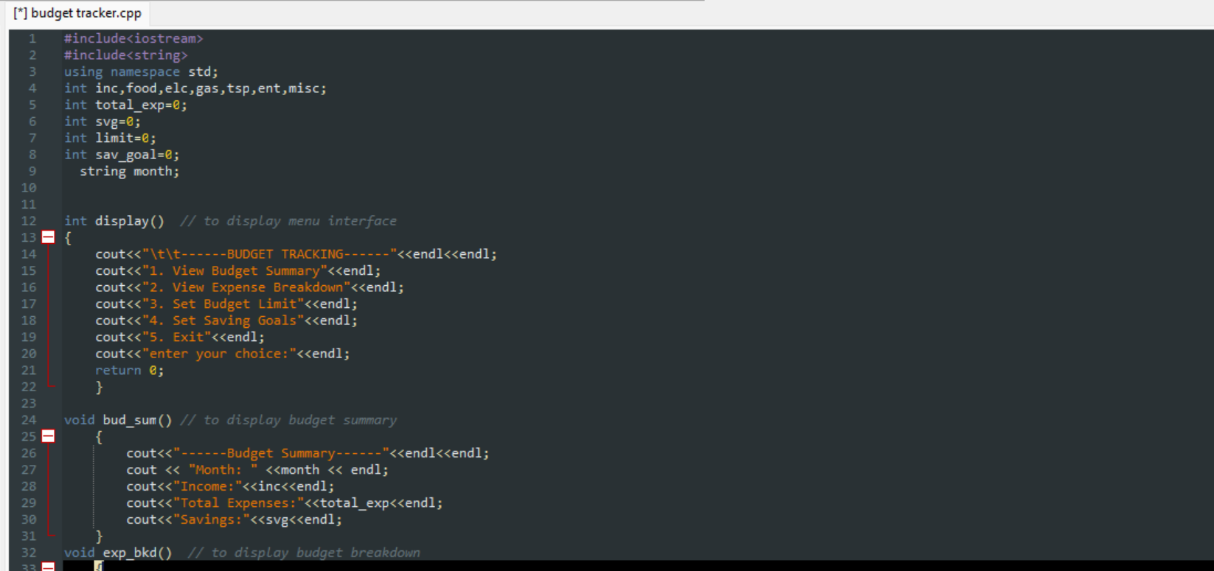
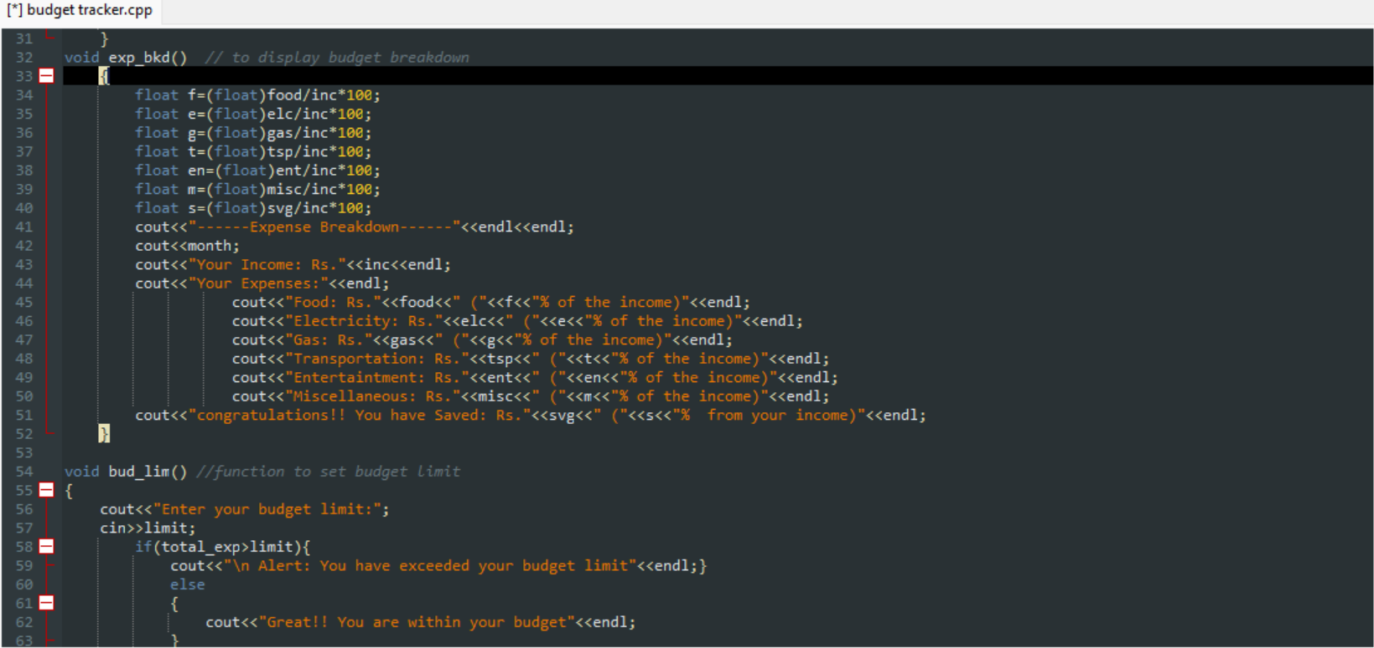
The code breakdown
In this code functions are used to enhance the productivity of the code and its useability
Iteration in main body to keep the code running unit the user asks to exit
Usage of functions have made the main body simpler and clean

